Slide 1
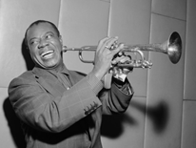
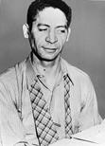
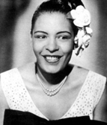
Music timeline 1919 - 2000
1919 After moving from its southern rural roots, jazz establishes Chicago as its capital. The city will become home to such jazz greats as trumpeter Louis Armstrong and pianist Jelly Roll Morton.
1923 “Queen of the Blues” Bessie Smith records her first song, “Down Hearted Blues,” which becomes an immediate success.

Slide 2
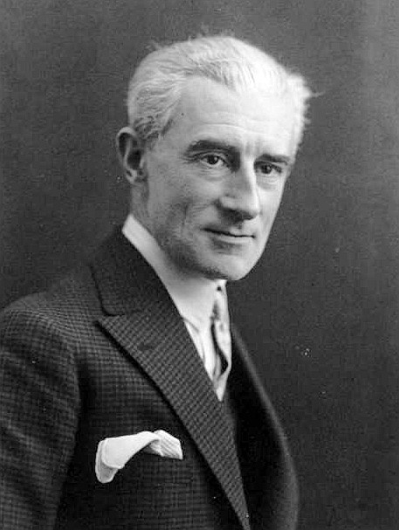
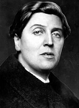
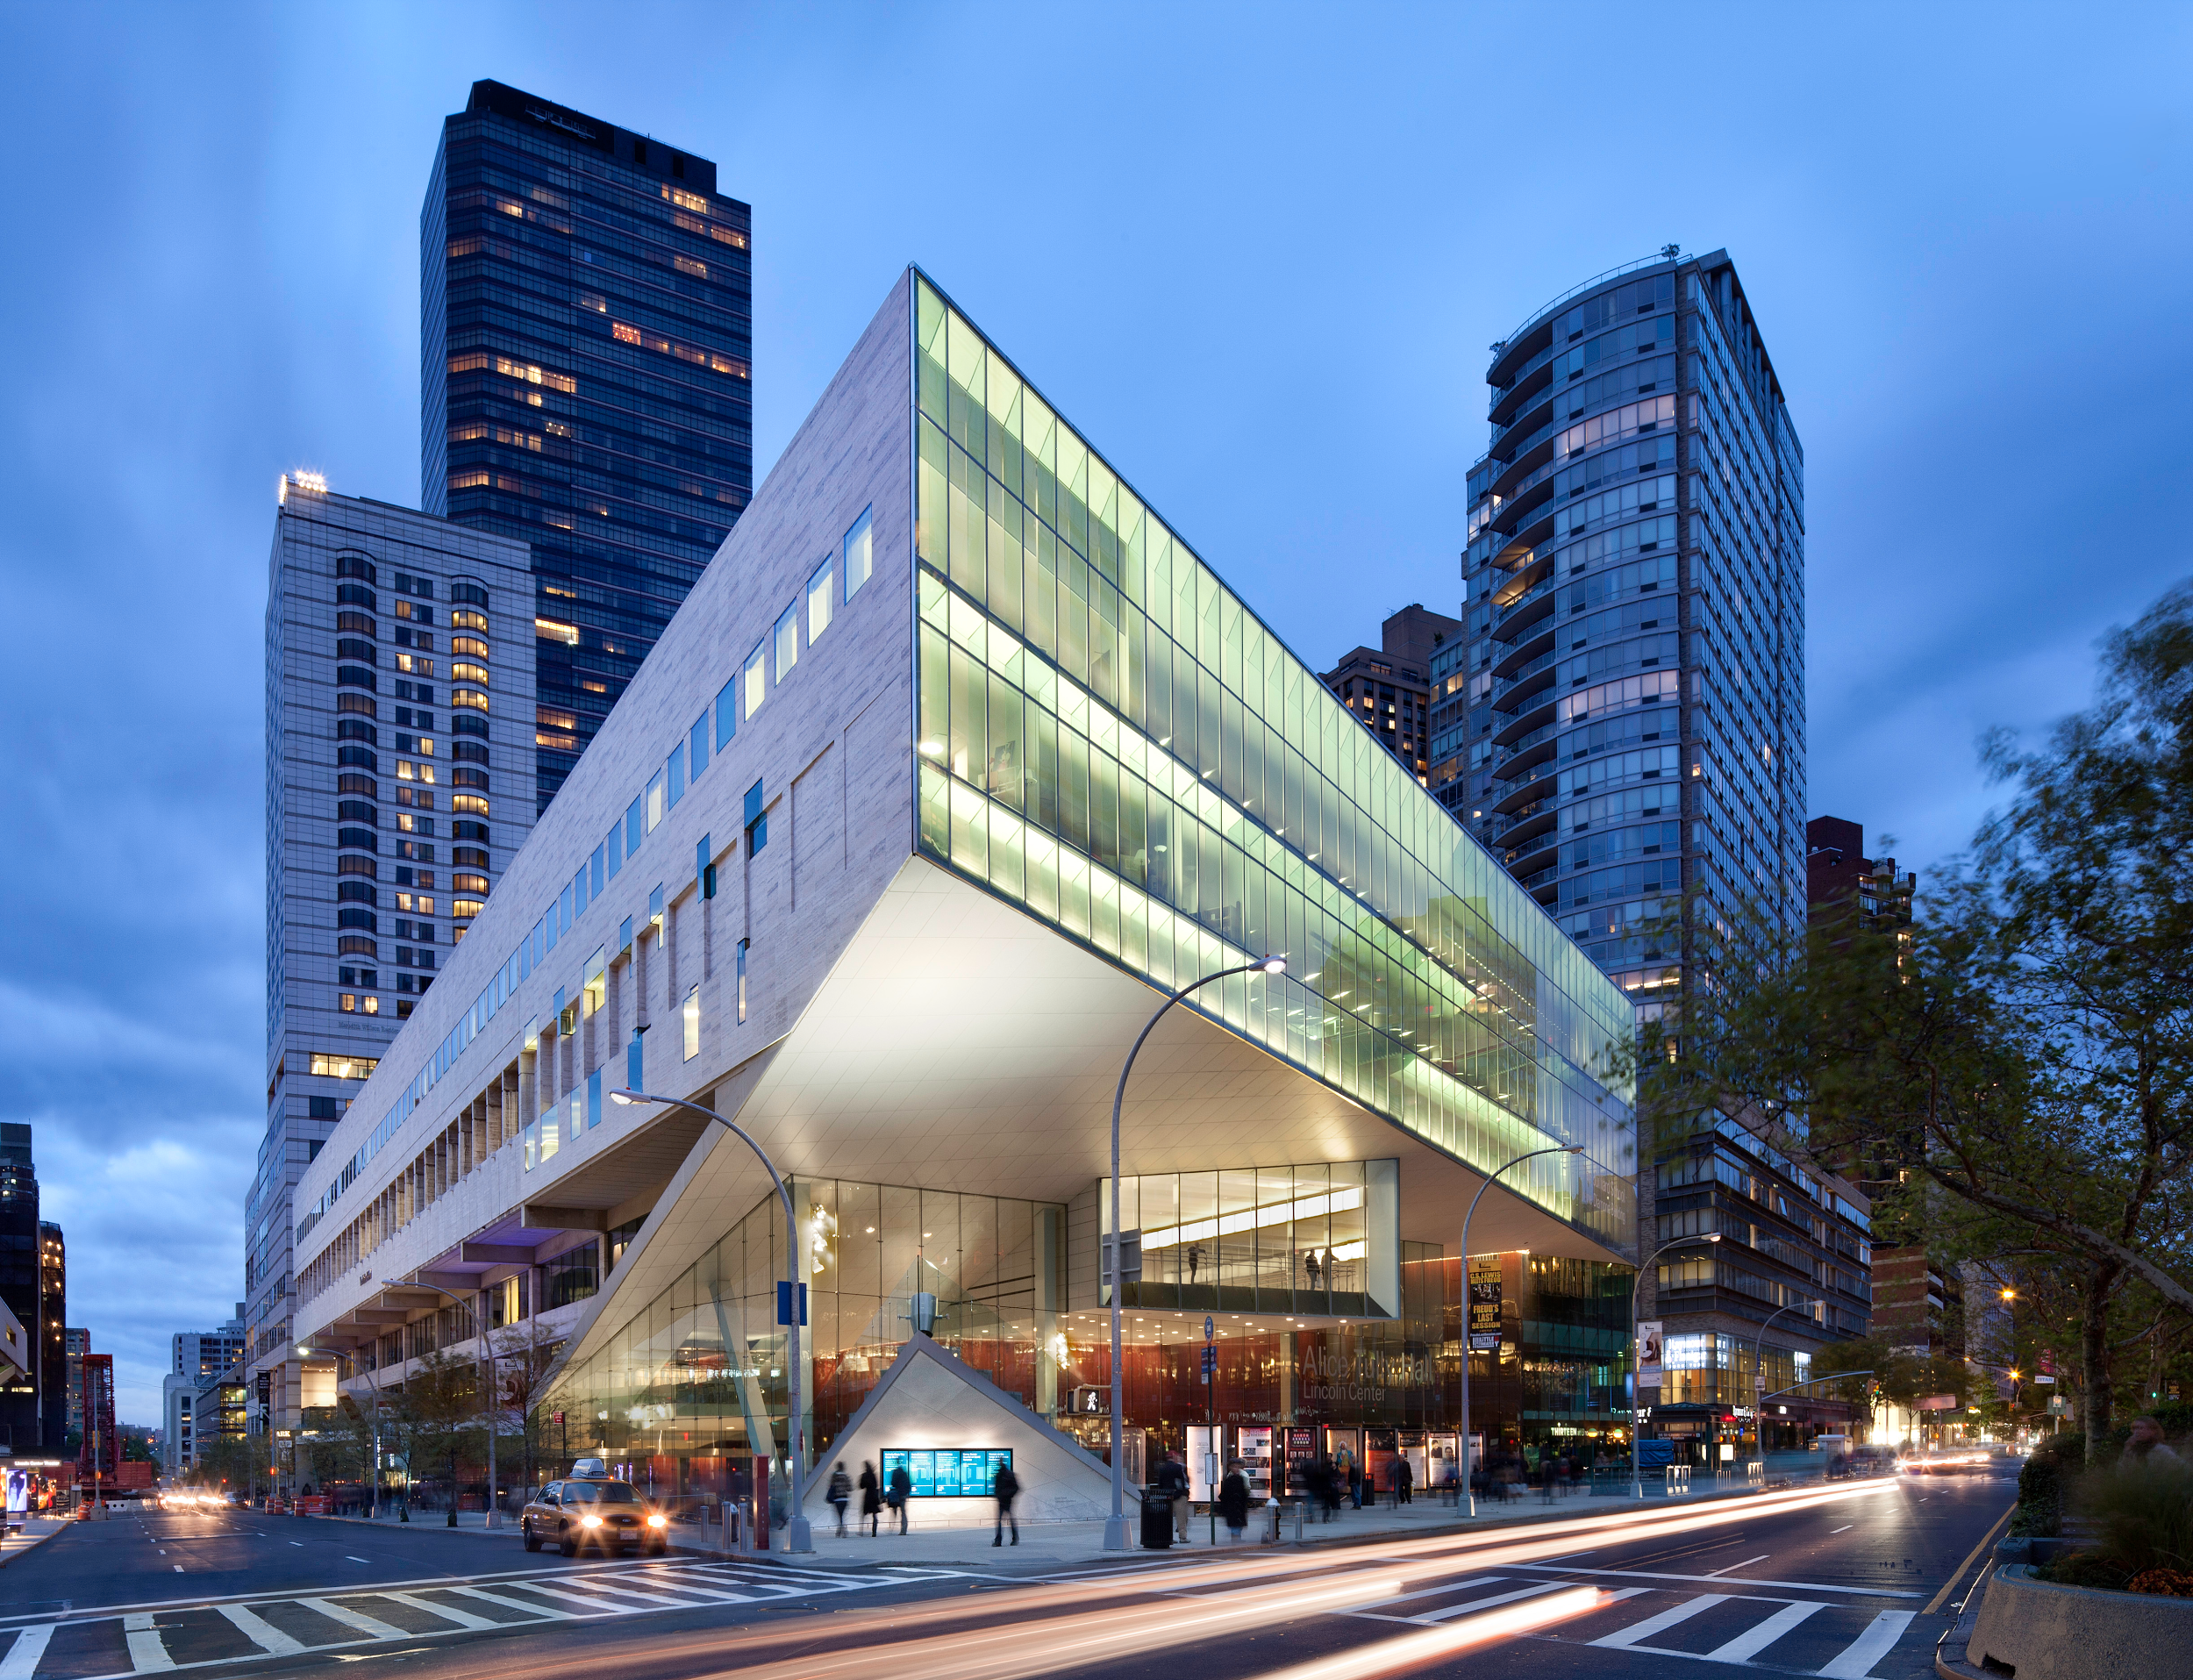

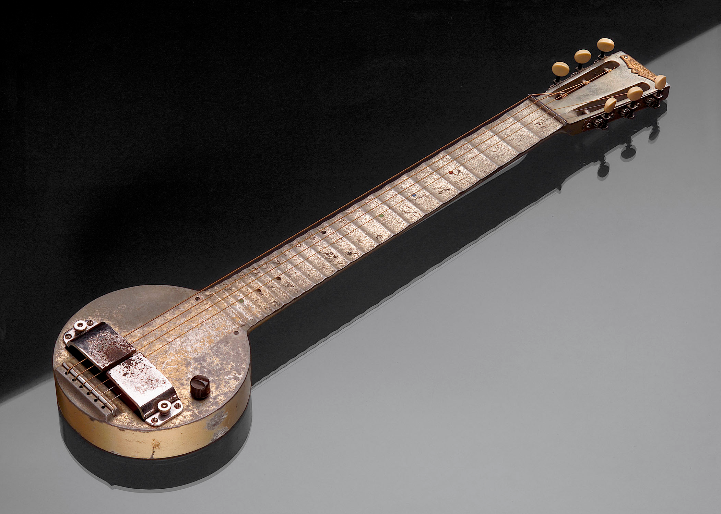
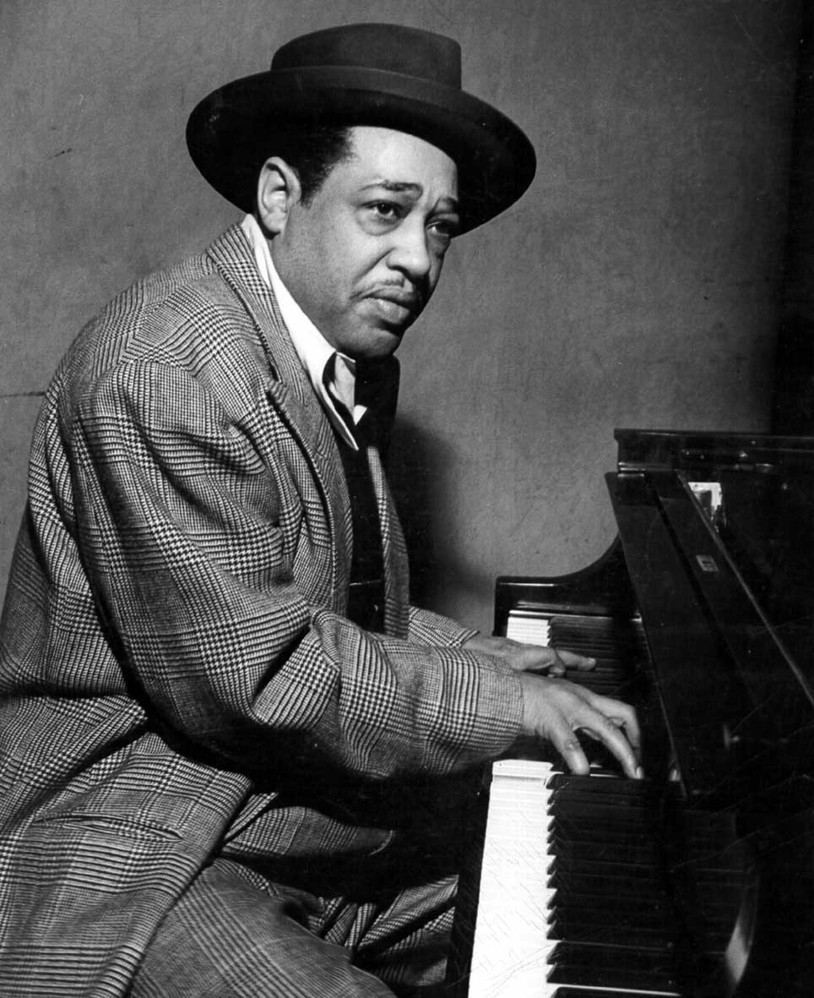
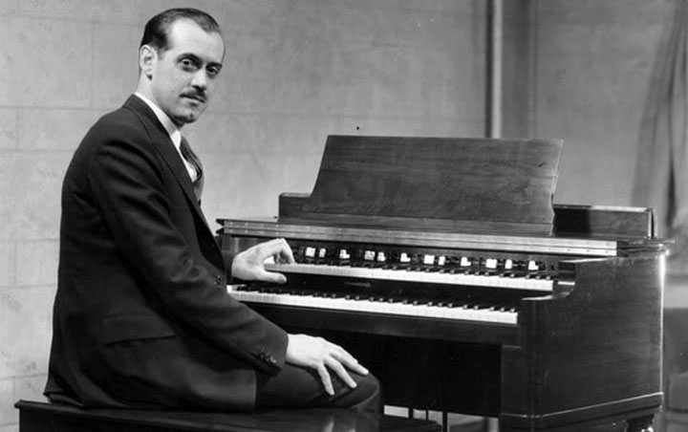
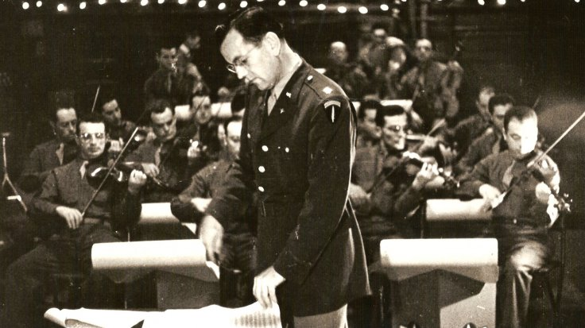
1924 The Juilliard School opens in New York. Established in 1905, it only opened in 1924
Maurice Ravel's Bolero opens in Paris.
1925 Alban Berg's Wozzeck opens in Berlin.
George Gershwin's Rhapsody in Blue premieres in New York.
1932 Jazz composer Duke Ellington writes “It Don't Mean a Thing, If It Ain't Got That Swing,” a song that presaged the swing era of the 1930s and 1940s.
1933 Laurens Hammond introduces his Hammond organ.
1936 Electric guitars debut.
The Glenn Miller Band debuts in New York. This band composed of army air force troops.

Slide 3
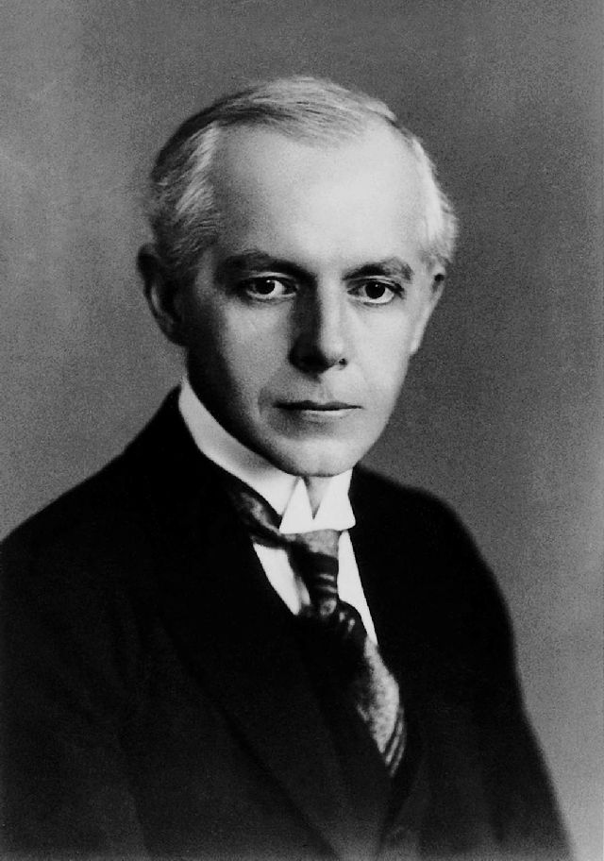
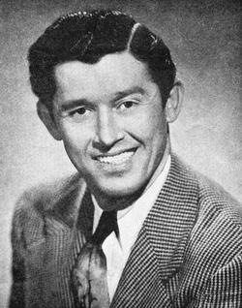
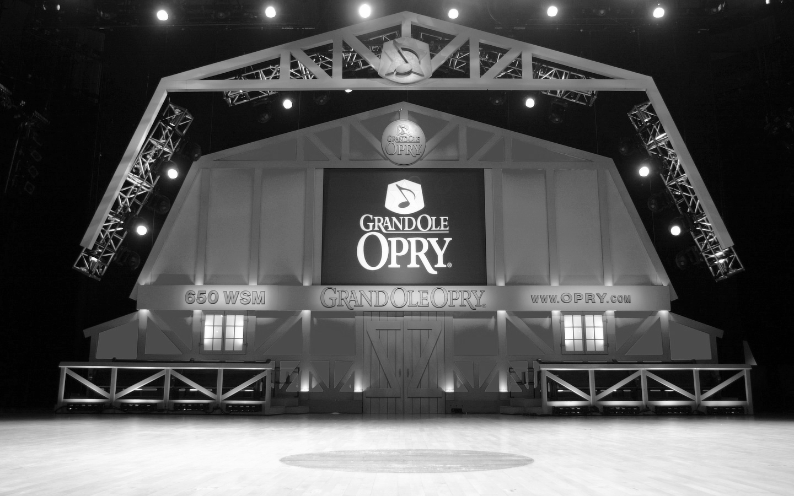
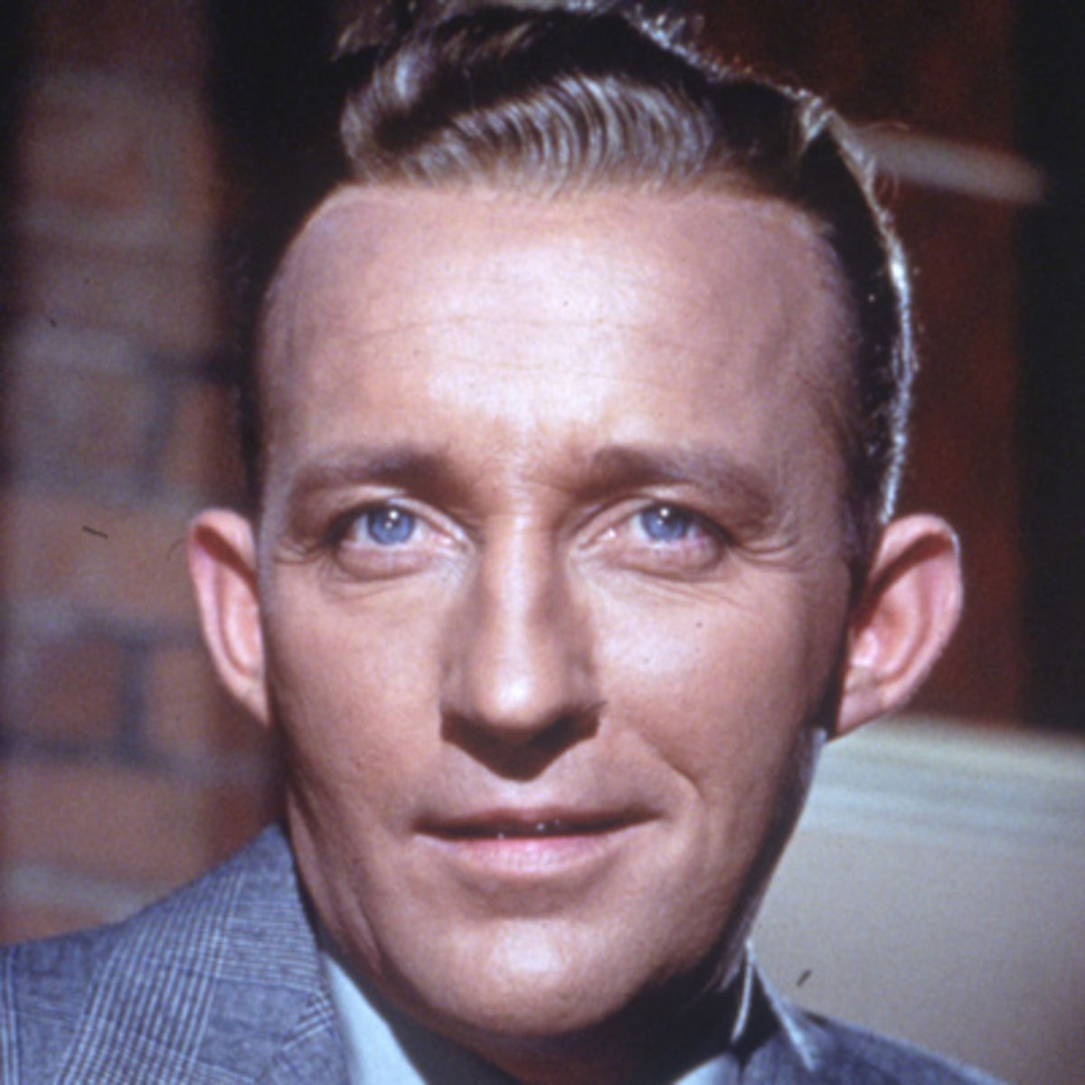
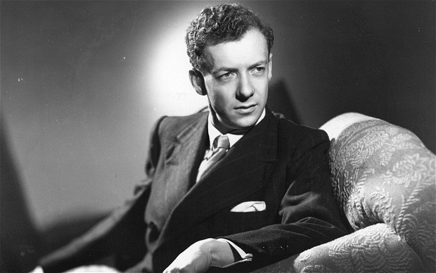
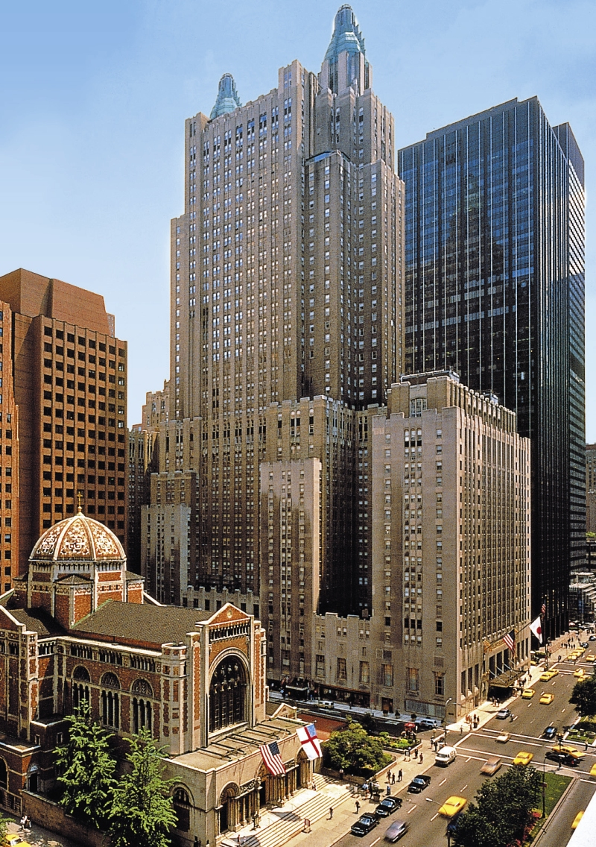
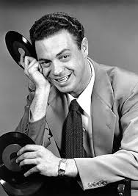
1937 Bela Bartok's masterpiece, Music for Strings, Percussion and Celesta, premieres in Basel.
1938 Roy Acuff joins the Grand Ole Opry and brings national recognition to the Nashville-based radio program.
1942 Bing Crosby releases "White Christmas," from the film Holiday Inn. The song goes on to be the all-time, top-selling song from a film.
RCA Victor sprays gold over Glenn Miller's million-copy-seller Chattanooga Choo Choo, creating the first "gold record."
1945 Benjamin Britten's Peter Grimes premieres in London, which signals the rebirth of British opera.
1948 Columbia Records introduces the 33 1/3 LP (“long playing”) record at New York's Waldorf-Astoria Hotel. It allows listeners to enjoy an unprecedented 25 minutes of music per side, compared to the four minutes per side of the standard 78 rpm record.
1951 In an effort to introduce rhythm and blues to a broader white audience, which was hesitant to embrace “black music,” disc jockey Alan Freed uses the term rock 'n' roll to describe R&B.
Elliott Carter composes his String Quartet No. 1 and becomes a leading avant-garde composer of the 20th century.

Slide 4
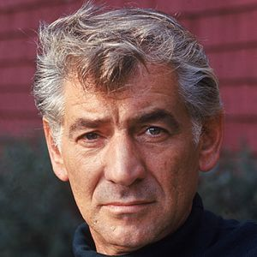
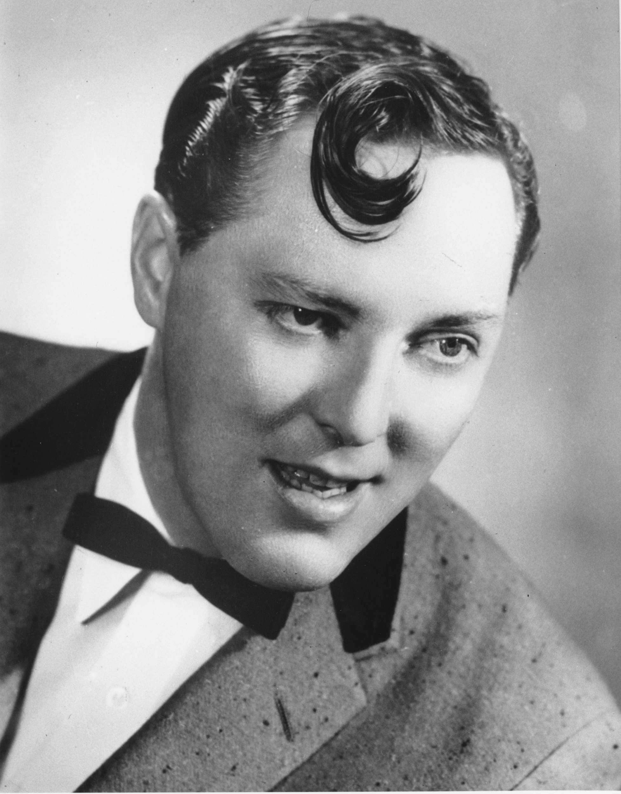
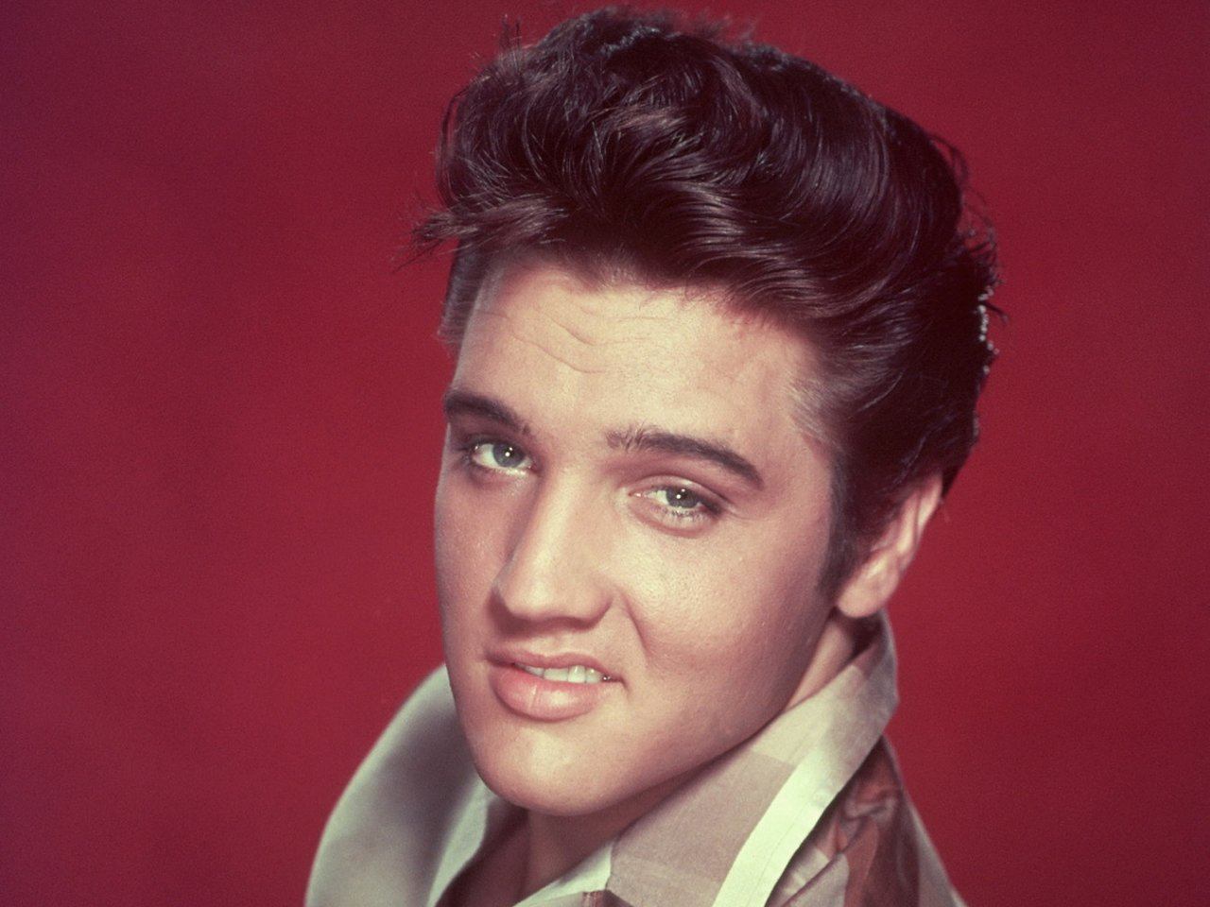
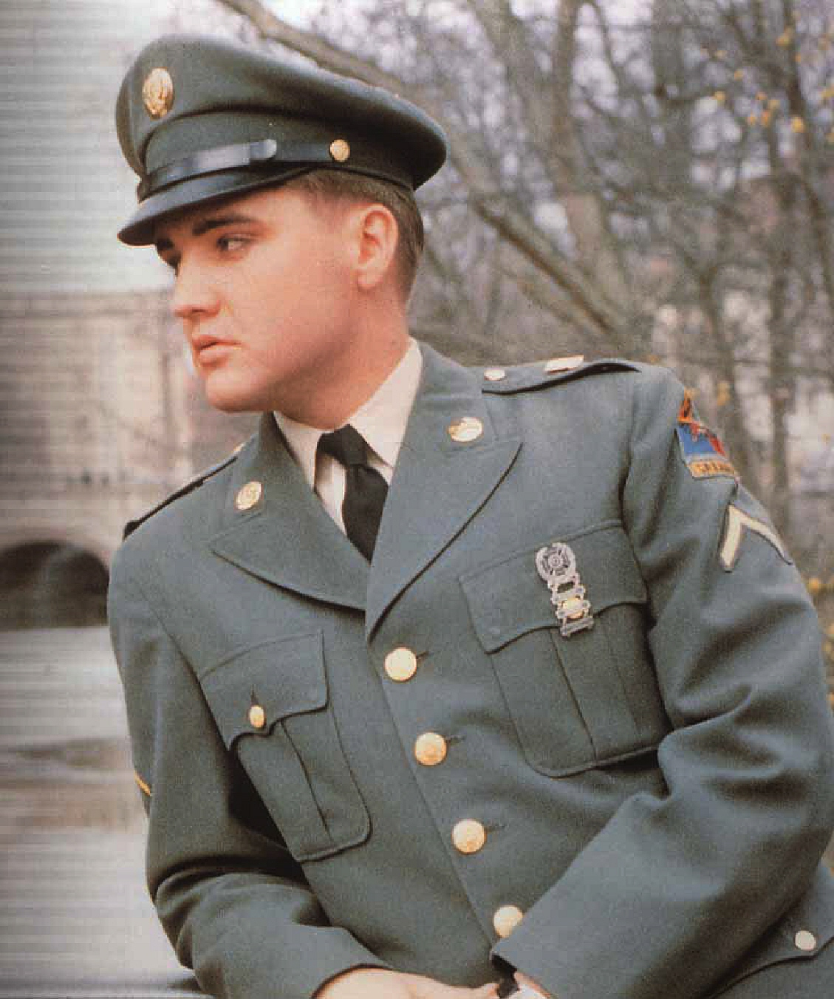
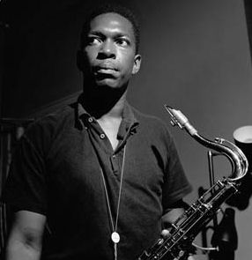
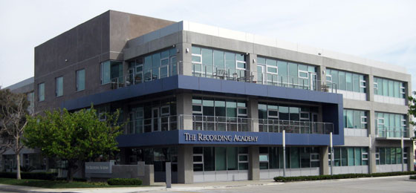
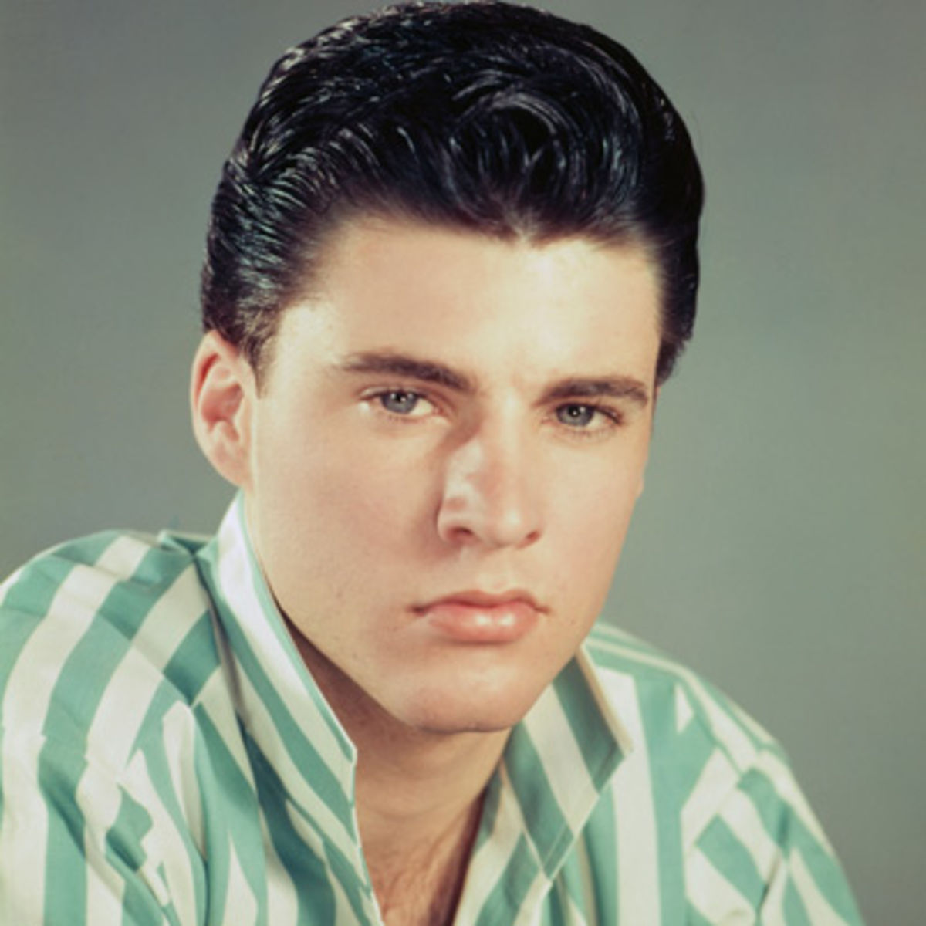
1954 Bill Haley and the Comets begin writing hit songs. As a white band using black-derived forms, they venture into rock 'n' roll.
Pierre Boulez completes Le Marteau Sans Maître (The Hammer Without a Master).
1957 Leonard Bernstein completes West Side Story.
1956 With many hit singles (including “Heartbreak Hotel”), Elvis Presley emerges as one of the world's first rock stars. The gyrating rocker enjoys fame on the stages of the Milton Berle, Steve Allen and Ed Sullivan shows, as well as in the first of his many movies, Love Me Tender.
1958 Billboard debuts its Hot 100 chart. Ricky Nelson's "Poor Little Fool" boasts the first No. 1 record. Elvis Presley is inducted into the U.S. Army (March 24).
1959 The National Academy of Recording Arts and Sciences sponsors the first Grammy Award ceremony for music recorded in 1958. Frank Sinatra wins his first Grammy Award -- Best Album for Come Dance with Me.
1960 John Coltrane forms his own quartet and becomes the voice of jazz's New Wave movement.

Slide 5
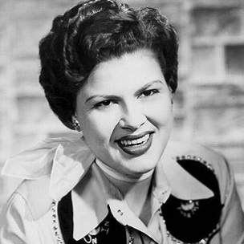
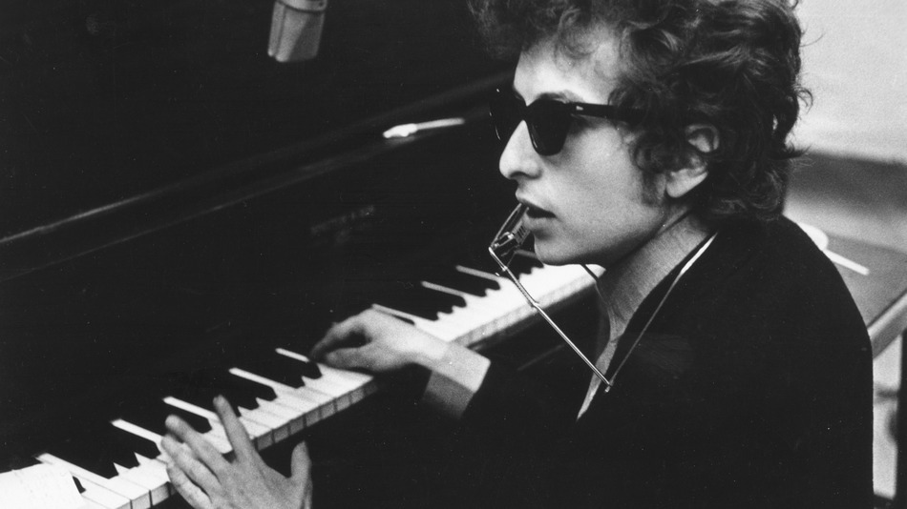
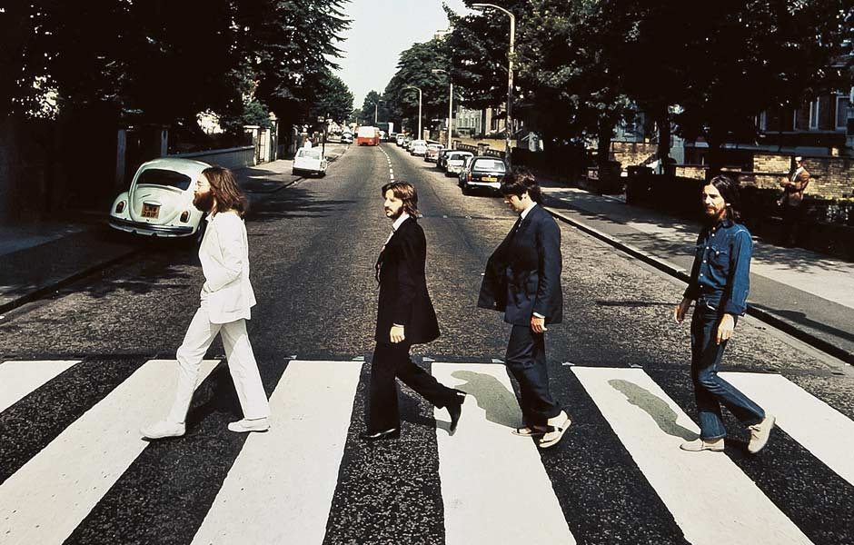
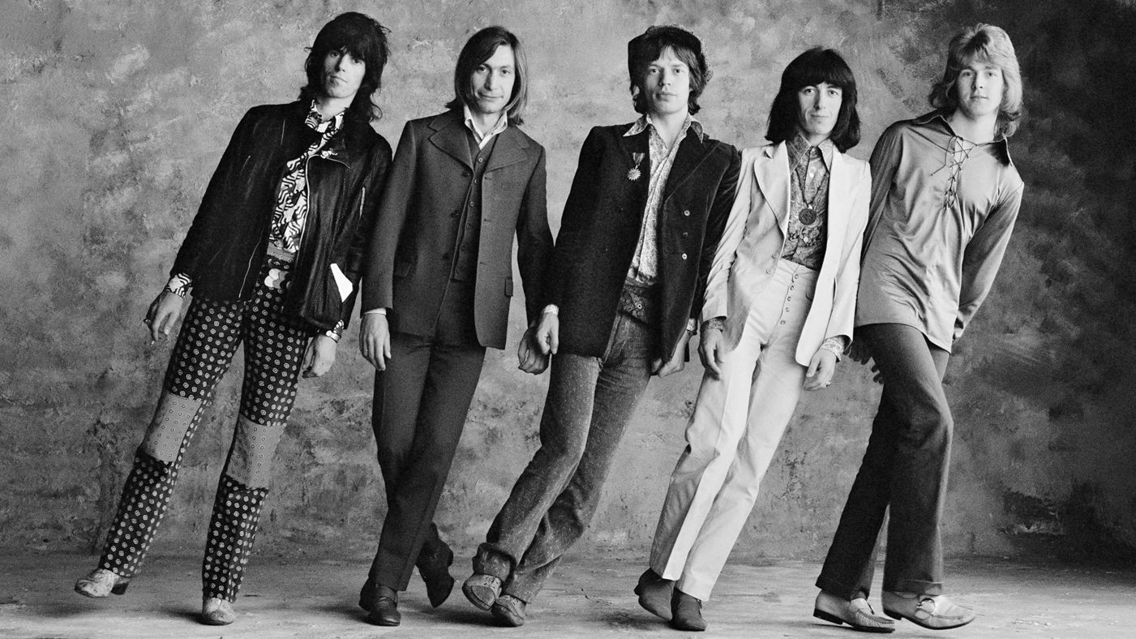
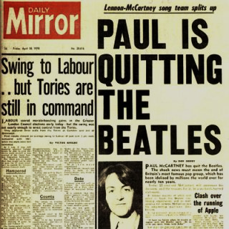
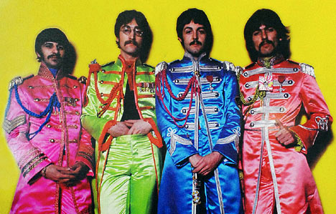
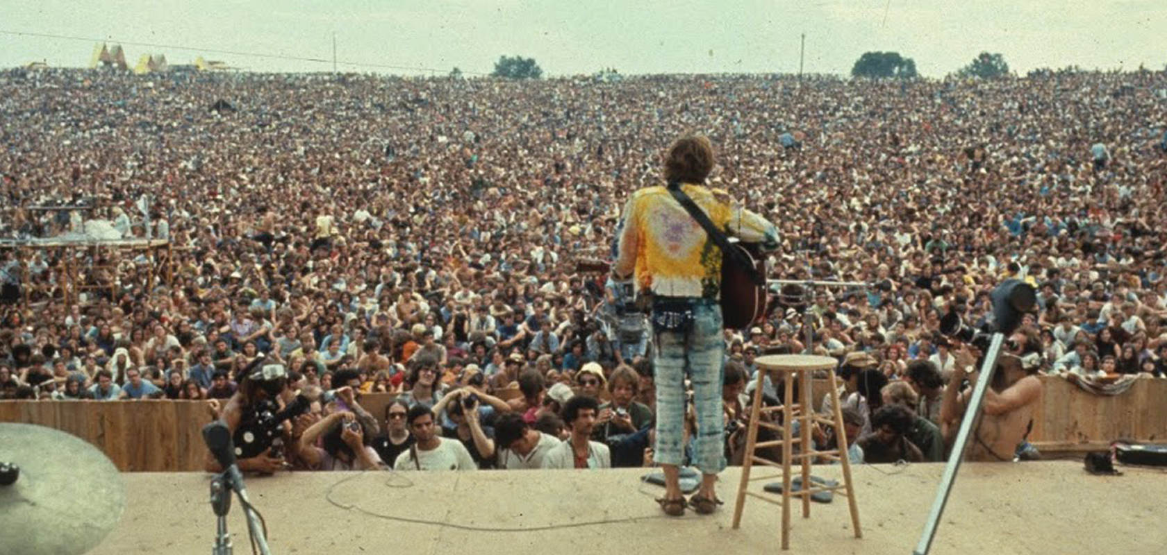
1961 Patsy Cline releases “I Fall to Pieces” and “Crazy.” The success of the songs help her cross over from country to pop.
1963 A wave of Beatlemania hits the U.K. The Beatles, a British band composed of John Lennon, George Harrison, Ringo Starr and Paul McCartney, take Britain by storm. The Rolling Stones emerge as the anti-Beatles, with an aggressive, blues-derived style.
1964 Folk musician Bob Dylan becomes increasingly popular during this time of social protest with songs expressing objection to the condition of American society. The Beatles appear on The Ed Sullivan Show.
1970 The Beatles break up. By the end of the year, each member had released a solo album.
1967 The Beatles release their break-through concept album, Sergeant Pepper's Lonely Hearts Club Band. Psychedelic bands such as The Grateful Dead and Jefferson Airplane enjoy great success during this period with songs celebrating the counterculture of the '60s.
1969 In August, more than half a million people attend the Woodstock music festival in Bethel, N.Y. (near Woodstock, N.Y.) Performers include Janis Joplin; Jimi Hendrix; The Who; Joan Baez; Crosby, Stills, Nash and Young; Jefferson Airplane; and Sly and the Family Stone. A Rolling Stones fan is killed at the group's Altamont, California, concert by members of the Hell's Angels.

Slide 6
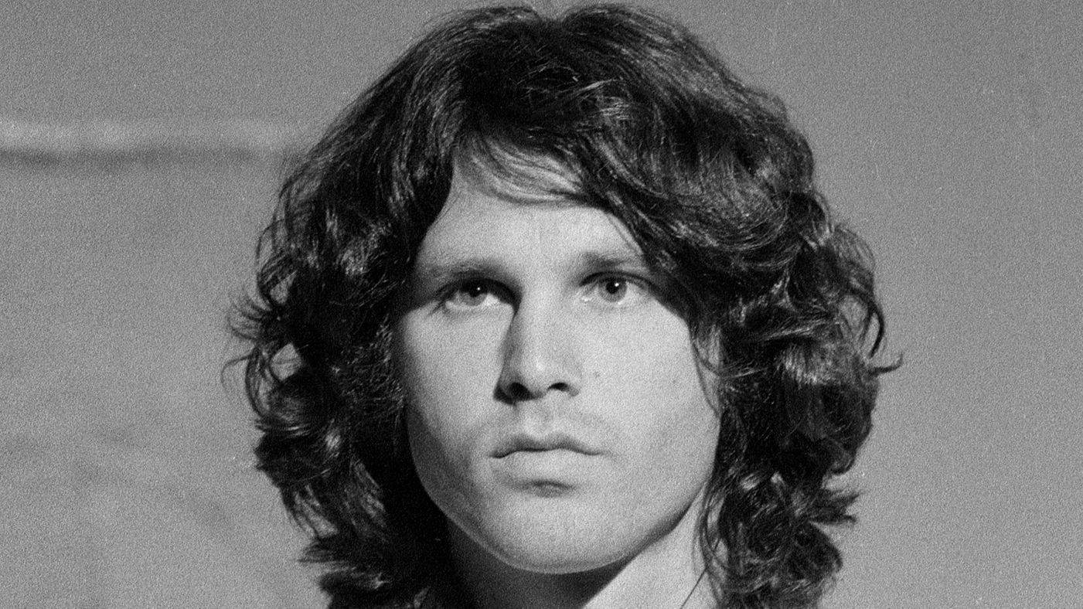
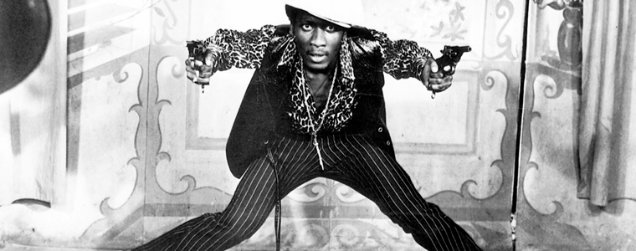
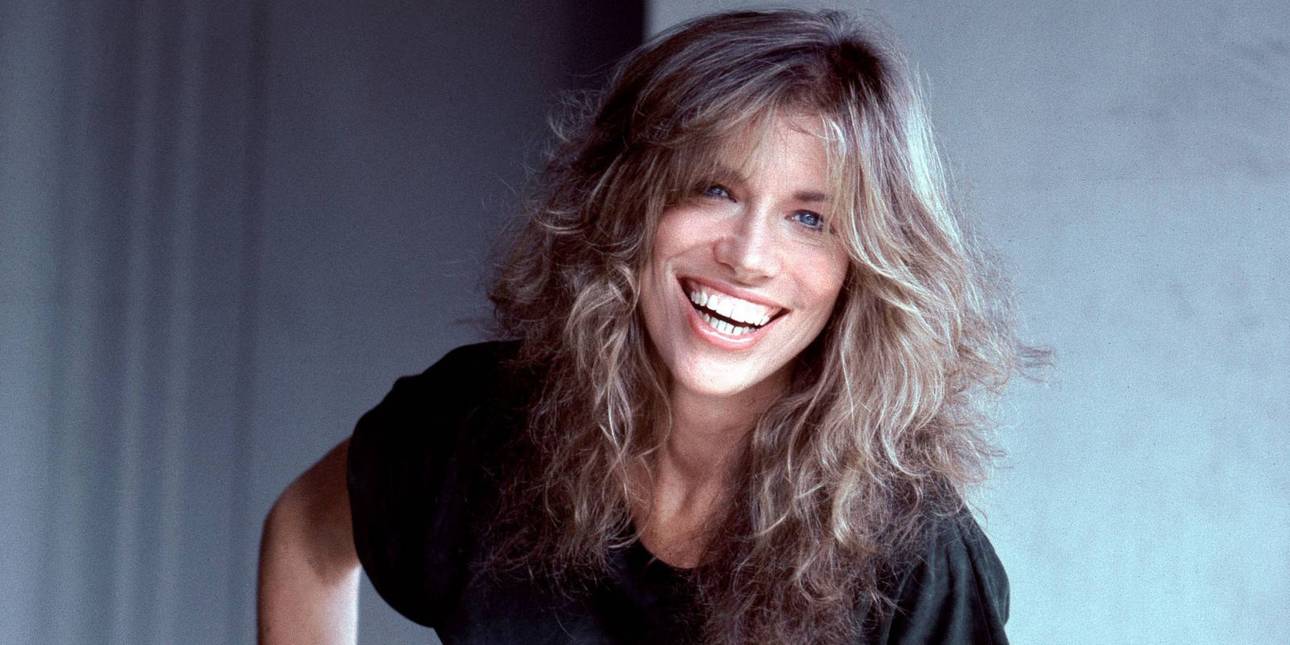
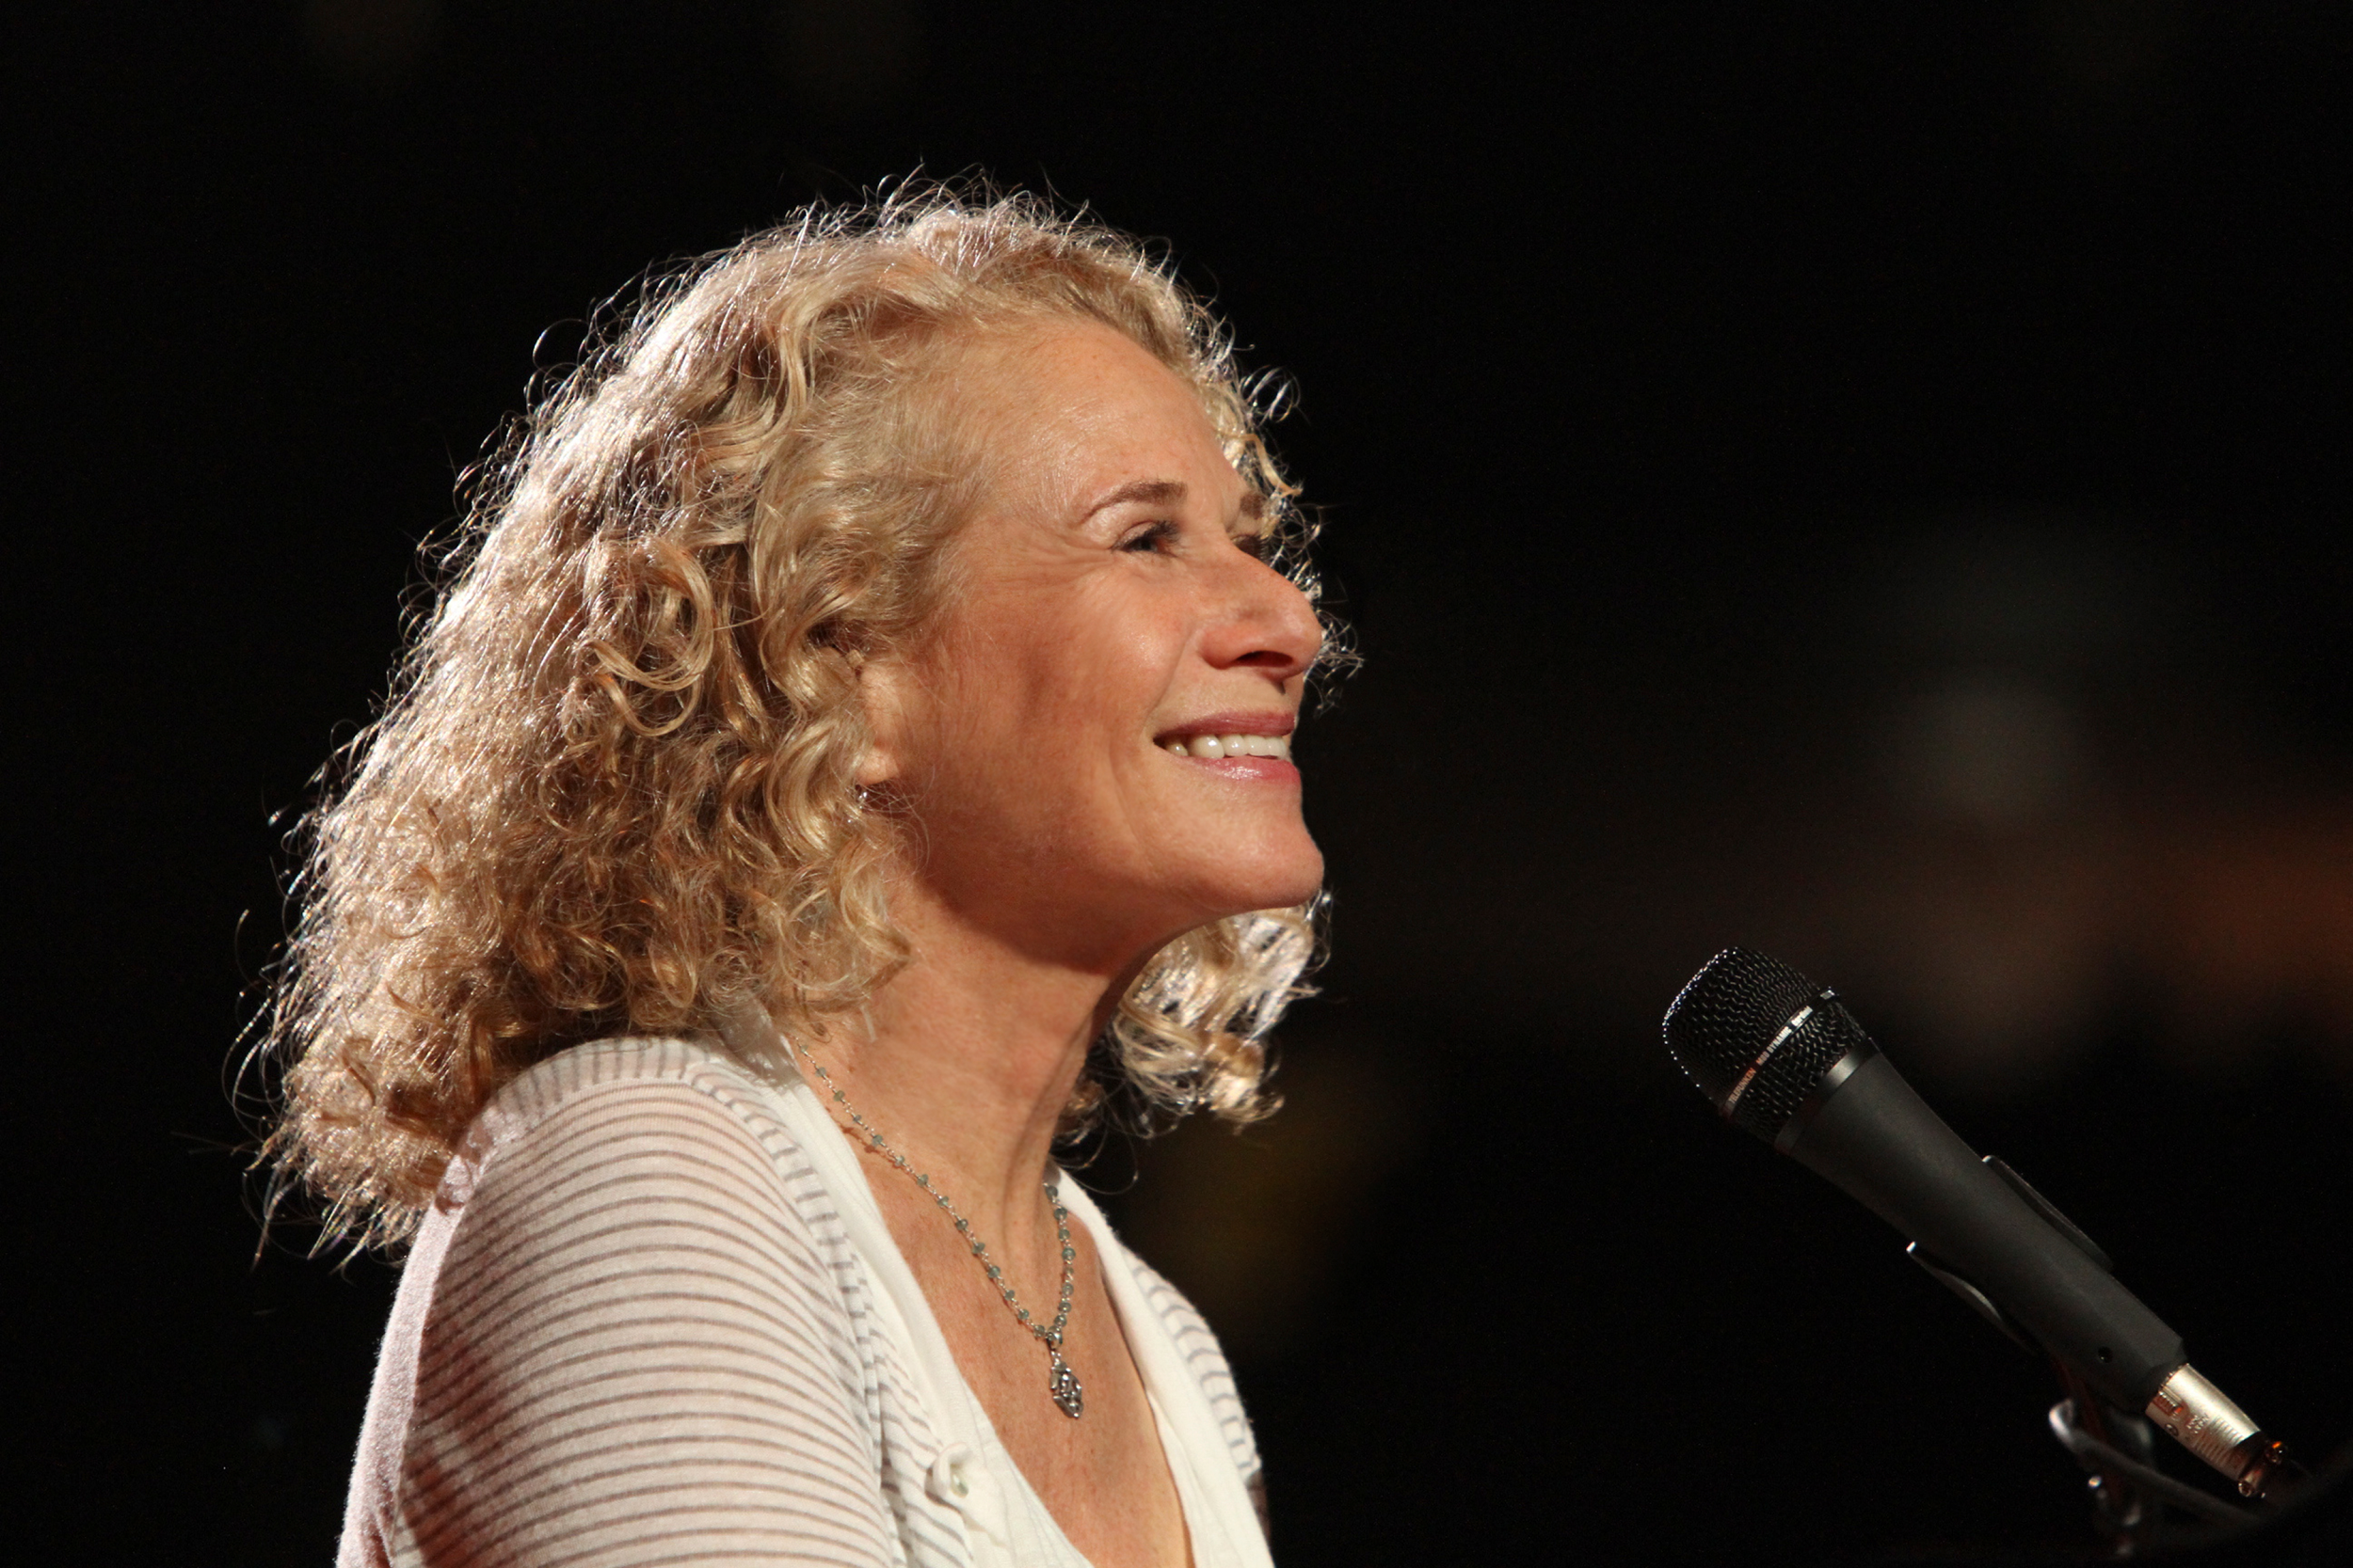
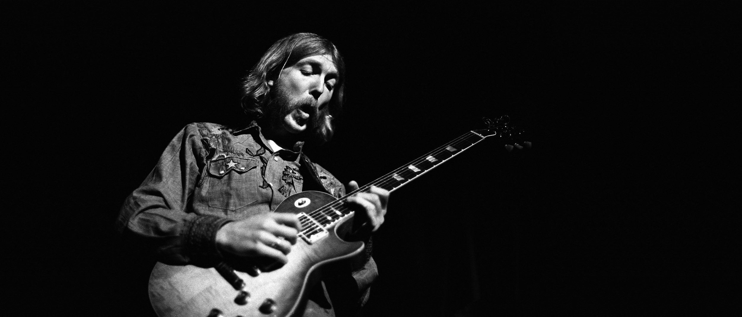
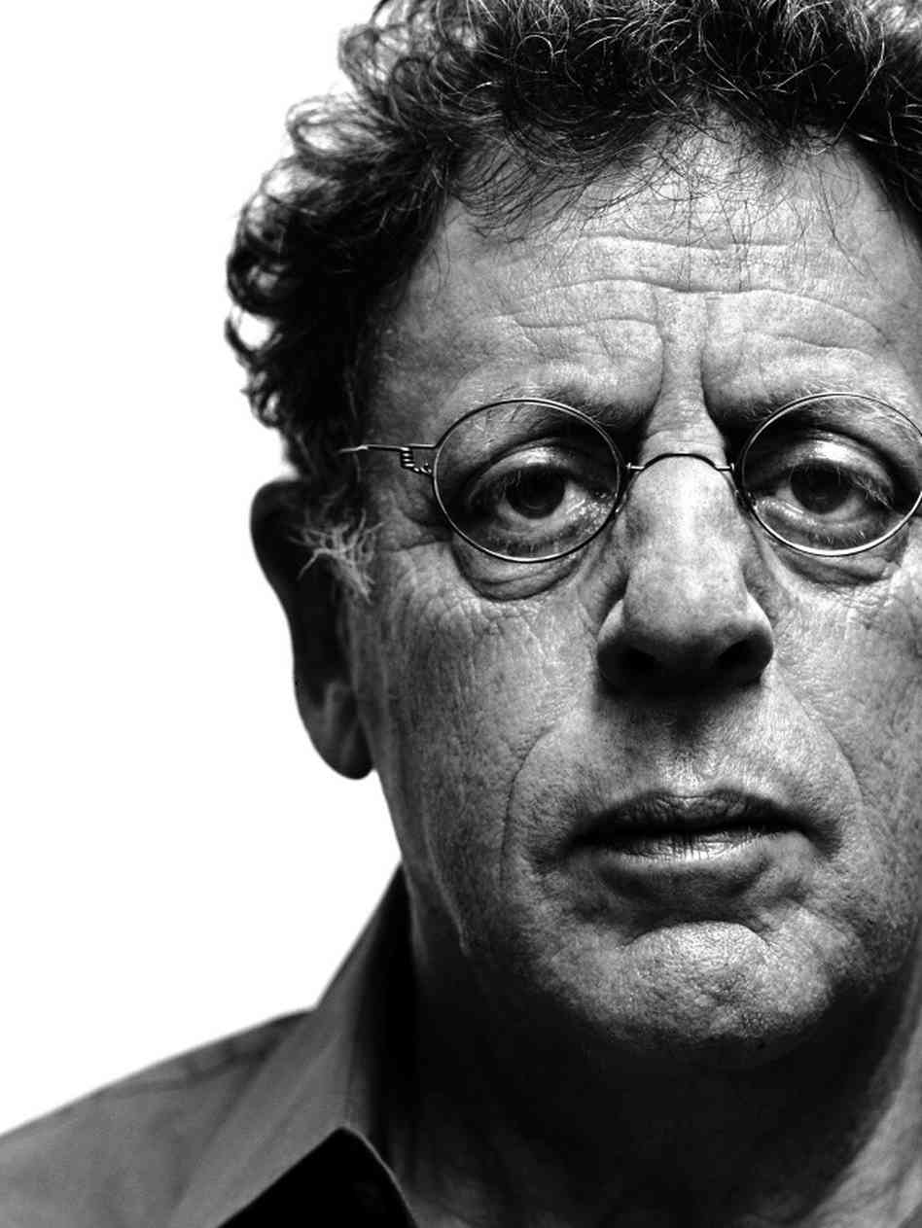
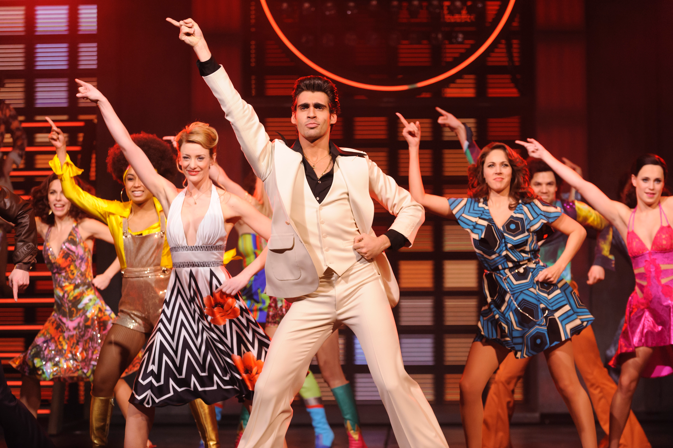
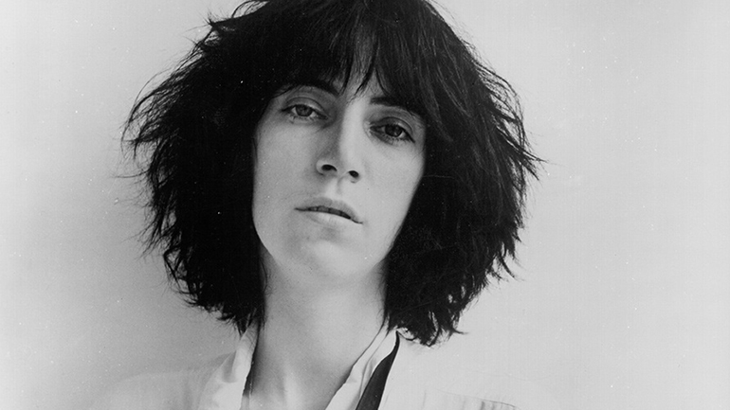
1971 Jim Morrison dies in Paris at age 27 (July 3). The Allman Brothers' Duane Allman dies in a motorcycle accident at age 24. (Oct. 29).
1972 Women dominate the 1971 Grammy Awards, taking all four top categories. Carole King won Record, Album and Song of the Year, while Carly Simon takes the Best New Artist award.
1973 The Jamaican film The Harder They Come, starring Jimmy Cliff, launches the popularity of reggae music in the United States.
1974 Patti Smith releases what is considered to be the first punk rock single, “Hey Joe.” Punk roars out of Britain during the late-'70s, with bands such as the Sex Pistols and the Clash expressing nihilistic and anarchistic views in response to a lack of opportunity in Britain, boredom, and antipathy for the bland music of the day.
1976 Philip Glass completes Einstein on the Beach, the first widely known example of minimalist composition.
1977 Saturday Night Fever sparks the disco inferno. Elvis Presley dies at Graceland, his Memphis, Tenn. home. He was 42.

Slide 7
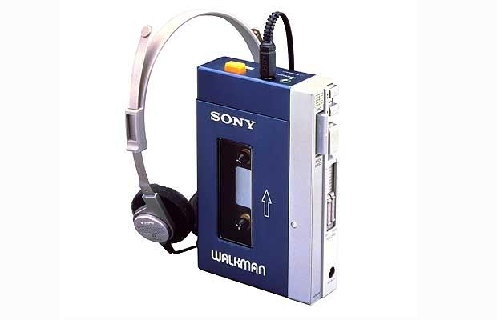

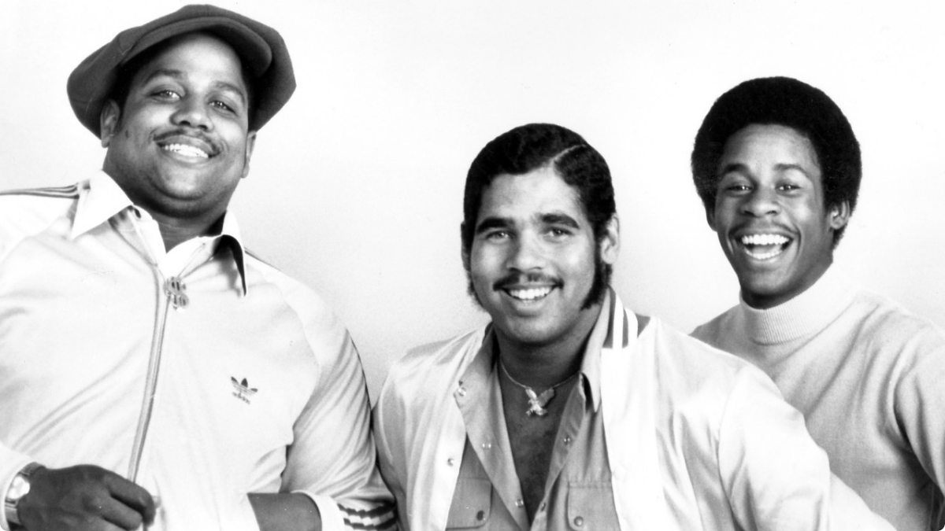

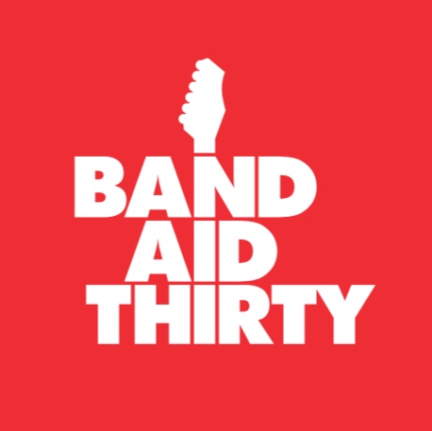
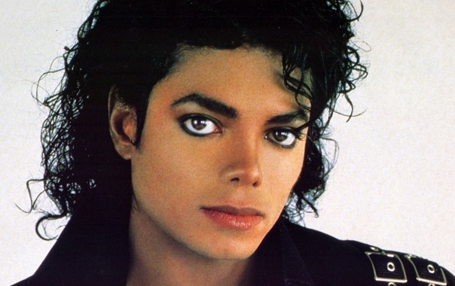
1978 Sony introduces the Walkman, the first portable stereo.
1979 The Sugar Hill Gang releases the first commercial rap hit, “Rapper's Delight,” bringing rap off the New York streets and into the popular music scene. Rap originated in the mid 1970s as rhyme spoken over an instrumental track provided by snatches of music from records. Over the decades, rap becomes one of the most important commercial and artistic branches of pop music.
1981 MTV goes on the air running around the clock music videos, debuting with “Video Killed the Radio Star.”
1983 With the introduction of noise-free compact discs, the vinyl record begins a steep decline.
1984 Led by Bob Geldof, the band Band Aid releases "Do They Know It's Christmas," with proceeds of the single going to feed the starving in Africa.
1982 Michael Jackson releases Thriller, which sells more than 25 million copies, becoming the biggest-selling album in history.

Slide 8
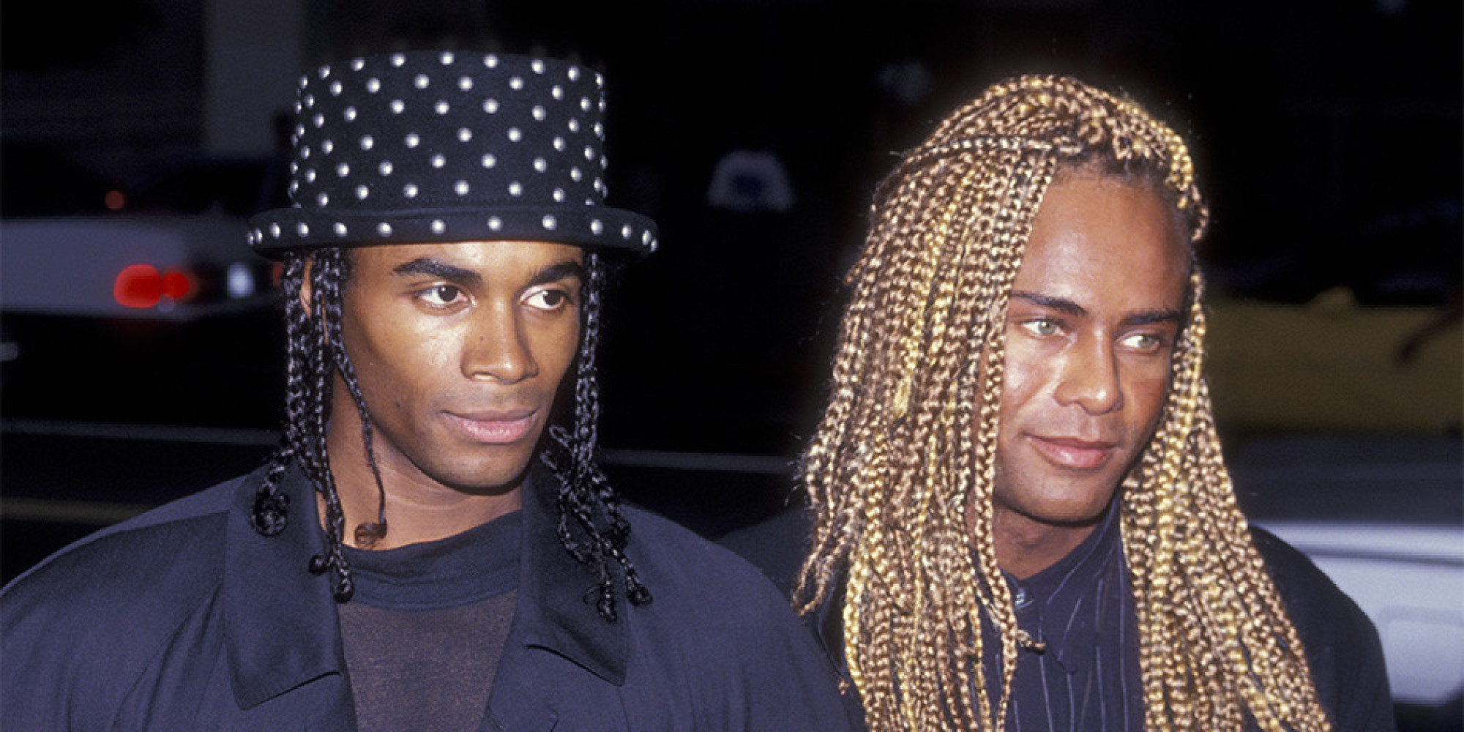
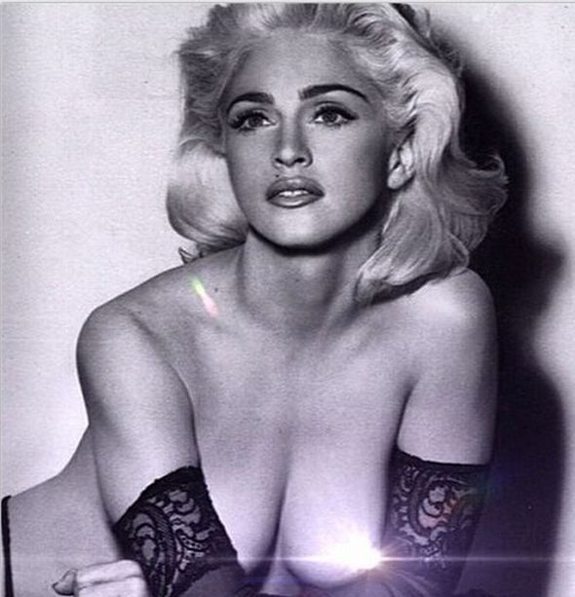
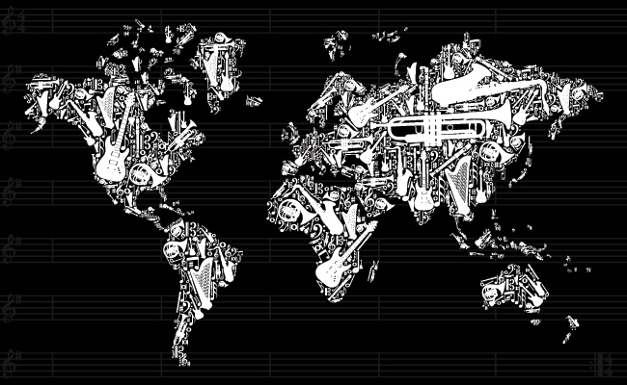
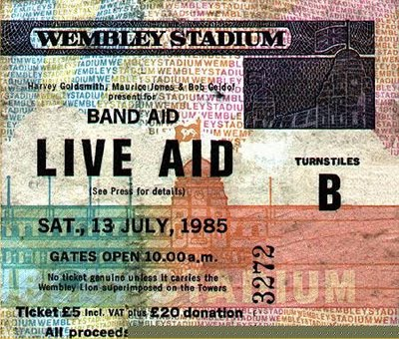
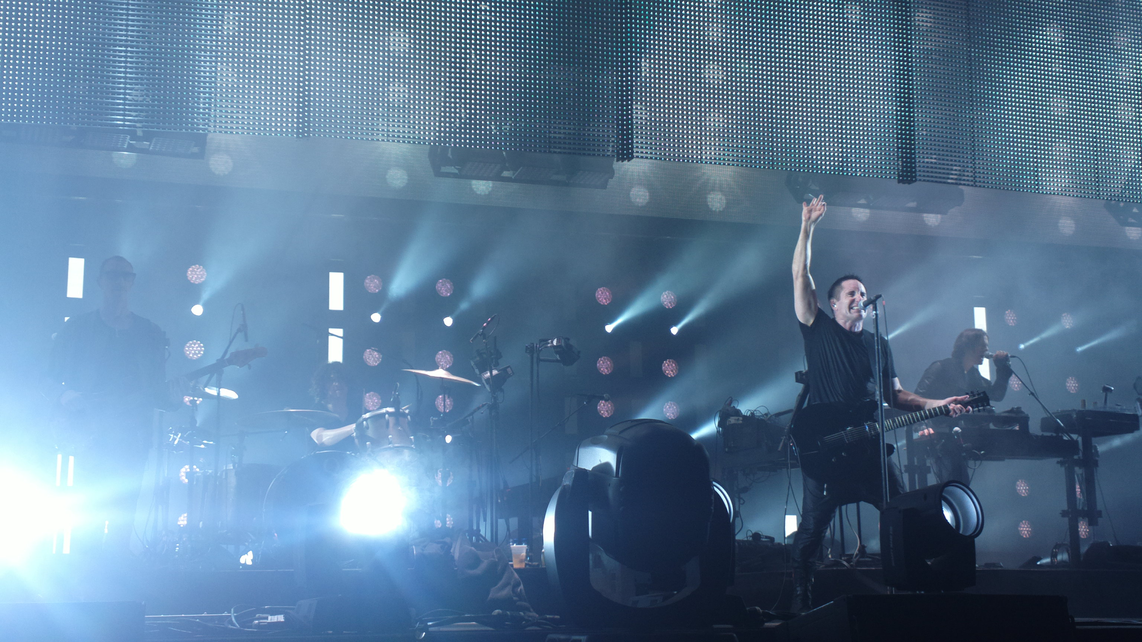
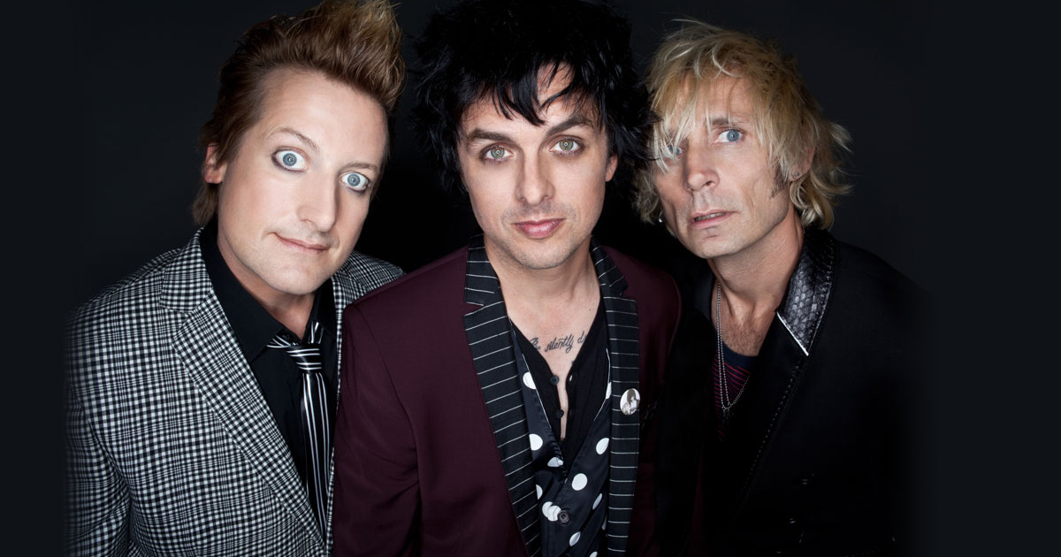
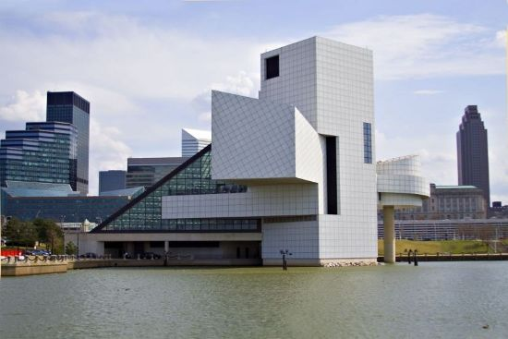


1985 Madonna launches her first road show, the Virgin Tour. Dozens of top-name musicians and bands perform at the Live Aid concerts in Philadelphia and London. The shows benefit African famine victims.
1987 Though African, Latin American, and other genres of international music have been around for centuries, a group of small, London-based labels coin the term “world music,” which helps record sellers find rack space for the eclectic music.
1990 Euro dance band Milli Vanilli admits to lip-synching hits such as "Girl You Know Its True," and has its Grammy award revoked.
1991 Seattle band Nirvana releases the song “Smells Like Teen Spirit” on the LP Nevermind and enjoys national success. With Nirvana's hit comes the grunge movement, which is characterized by distorted guitars, dispirited vocals, and lots of flannel.
1994 Woodstock '94 commemorates the original weekend-long concert. Green Day and Nine Inch Nails join Woodstock veterans including Santana and Joe Cocker.
1995 The Rock and Roll Hall of Fame Museum opens in Cleveland. Renowned architect I. M. Pei designed the ultra-modern, 150,000 square-foot building. Grateful Dead frontman Jerry Garcia dies.

Slide 9



1996 Janet Jackson becomes the highest-paid musician in history when she signs an $80-million deal with Virgin Records. Jazz great Ella Fitzgerald dies.
1998 Legendary crooner Frank Sinatra dies of a heart attack at age 82.
1999 The merger of two major recording labels, Universal and Polygram, causes upheaval in the recording industry. It is estimated that the new company, Universal Music Group, controls 25% of the worldwide music market. Woodstock '99 kicks off in Rome, N.Y. Concertgoers complain that the spirit of the original Woodstock has been compromised and commercialized.
2000 The Internet transforms music scene as companies offer free music over the Internet without paying copyright fees. Music industry executives take the issue to court. A ruling prompts Napster to stop distributing copyrighted music free and team up with industry giant Bertelsmann to provide material for a fee.

